Slide 1
Kindergarten Orientation

Slide 2
Medical Forms needed for registration
Birth Certificate
Bring an original copy of your students birth certificate, the office will make a copy and return the original to you.
Immunization Records
Per state law, students must be up to date on immunizations before school starts.
Bring an original copy of your students immunization record, the office will make a copy and return the original to you.
Exemptions may be done through the health department, a record of each exemption must be provided to the school.
Reduced cost or free immunizations may be available through the Health Department

Slide 3
Vision Screens
It is recommended you have your students vision screened before starting Kindergarten. This can be part of a Kindergarten physical at your request.
We have mass vision screens every fall for Kindergarten, 1st, 3rd and 5th graders. If your student does not pass this screen a referral letter will be sent home. This is an opt-out program.
Vouchers and discount coupons for glasses are available upon request for qualifying families.

Slide 4
Medications at School
Any medication at school requires a Medication Authorization form signed by the students doctor on file at school. This includes cough drops, essential oils and over the counter medications. This form is renewed annually.
Elementary students may not self-carry medications except inhalers, Epi-Pens, and diabetes medications with the proper medication forms on file. All other medications are to be kept locked in the office.
front office is trained annually on medication storage and administration.
The school does not stock and will not administer any medication to your student unless ordered by your doctor and provided by you.
Any medications at school must be picked up at the end of every year.

Slide 5
Healthcare Plans
If your student has a health condition such as diabetes, seizures, food allergy’s, heart issues, or anything else, you may want a healthcare plan.
This is an official document that helps inform teachers and other school staff of your students condition.
You will work together with the school nurse to create a healthcare plan specific for your child.
Please fill out a Request for Special Health Services form and return it to the office to get in touch with your school nurse. This form is renewed annually.

Slide 6
Sick kids stay home
Fever, Vomiting, and diarrhea are contagious. If your student has these symptoms they should stay home until they are without symptoms for 24 hours. See district exclusion guidelines for more detail.
There may be students at school who are immunocompromised and are more susceptible to serious illness. We appreciate your good judgement in deciding whether or not to send your child to school.
This is a great time to be sure your child has good handwashing skills and practices good sneeze and cough hygiene.

Slide 7
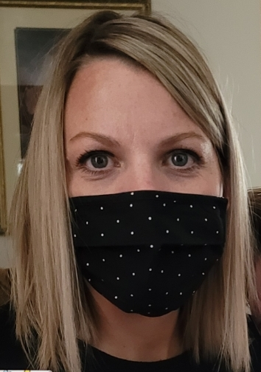
School Nurse Information
Melanie Breeze
Melanie.breeze@jordandistrict.org
Office: (801) 280-0722
Cell: (385) 215-4312
Falcon Ridge Elementary, Hayden Peak Elementary, Westvale Elementary, West Jordan Elementary, WJHS

